Slide 1
In memoriam of Prof. Włodzimierz Walczak
‚Let us hurry to love people, they leave us too soon…’
Ks. Jan Twardowski

Slide 2
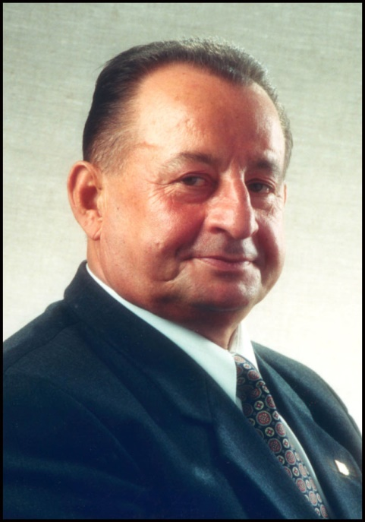
August 14, 2012, died Prof. Dr. eng. Włodzimierz Walczak.
He was a true authority for many generations of welders.
Moreover, he was not only a great teacher and brilliant manager at the Department of Welding Engineering of Gdansk University of Technology, but also a friend.
In few slides let us present some of the achievements
of Prof. Walczak, who was one of the first engineers
working on explosive cladding and not only…

Slide 3
Włodzimierz Walczak graduated from the Gdansk University of Technology, Faculty of Mechanical Engineering, in 1961.
He got his Doctoral degree at the Faculty of Mechanical Engineering, Gdansk University of Technology in 1968. His doctoral thesis was devoted to the influence of collision angle and amount of explosive on the character of explosive welding
in the steel–copper pair and seam quality.
In 1978 he moved to Warsaw to work at Warsaw University of Technology, where he did his habilitation.
In August 1991, he got a position of professor at the Gdansk University of Technology and in 2002 the official rank of full professor.

Slide 4
During his career, Professor Walczak worked in the following important positions
at the Gdansk University of Technology :
1979–1985: Director, Institute of Materials Technology and Welding Machines
1987–1988: Dean, Faculty of Mechanical Engineering
1999–2002: Dean, Faculty of Mechanical Engineering
He was a director of the Department of Materials Technology and Welding Machines until 2007.

Slide 5
Since 1963, Professor was involved in research focused on explosive cladding of metals. He was a world renowned authority on this field, creating his own scientific school.
His professional achievements in the topic of explosive cladding were documented in 2 books, 2 monographs, 1 habilitation, 4 doctoral dissertations, 50 master's thesis, 9 patents and over 120 other publications.
Prof. Walczak’s team was one of the few in Poland and in Europe, manufacturers of welding connectors: steel + Al + AlMg. His team also established the technology of cladding of many other metals for various applications.

Slide 6
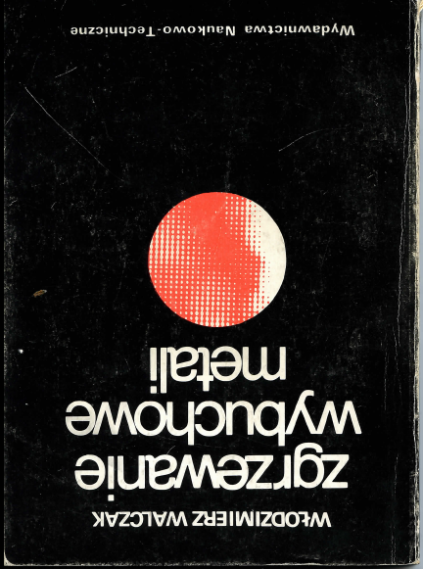
Many years of his work were summarized by a release of a book: 'Explosive welding of metals’.

Slide 7
In addition to his teaching activity, which he considered to be the most important, Professor was engaged in extensive scientific and educational activities.
Since 1968 he was a chairman of the Provincial Committee of the Welding. He was an active member of the Welding Society of Polish Mechanical Engineers and Polish Federation of Engineering Associations.
He was a long-standing member of the Welding Institute in Gliwice, a member of the Technical Board of the Polish Register of Shipping and the editor of the Review of Welding.
He was many times awarded for his achievements and honored with following national awards: Silver and Gold Cross of Merit, Order of Polonia Restituta and Medal of the National Education Commission and others.

Slide 8
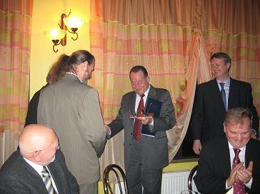
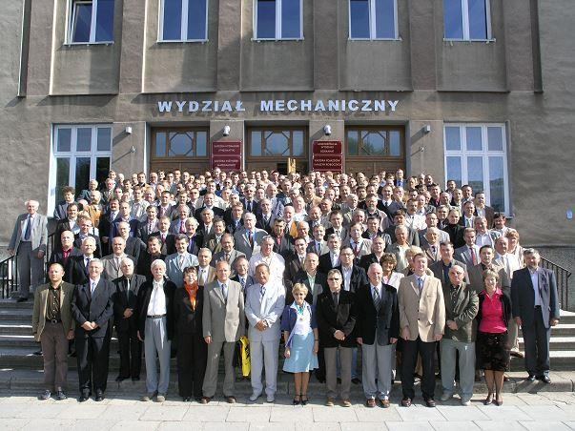
He was not only a great scientist, but also a mentor, a friend, a colleauge…
Prof. Dr. eng. W. Walczak with friends from Faculty during the New Year party in 2008.
XII Meeting of Welding Engineers of the Coast in 2008 .
…his memory will stay with us forever.
Thank you

